Slide 1
Equivalent Partitioning
Equivalence partitioning is a black-box testing method that divides the input domain of a program into classes of data from which test cases can be derived.
Test-case design for equivalence partitioning is based on an evaluation of equivalence classes for an input condition

Slide 2
Equivalence classes may be defined according to the following guidelines:
If an input condition specifies a range, one valid and two invalid equivalence classes are defined.
If an input condition requires a specific value, one valid and two invalid equivalence classes are defined.
If an input condition specifies a member of a set, one valid and one invalid equivalence class are defined.
If an input condition is Boolean, one valid and one invalid class are defined.

Slide 3
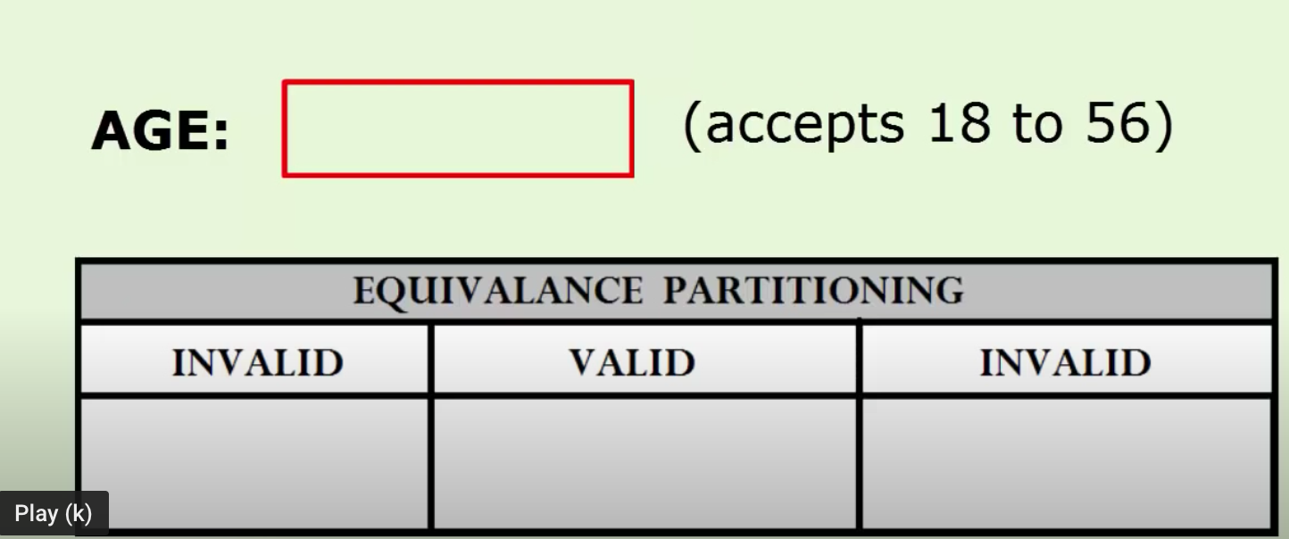
Equivalent Partitioning

Slide 4
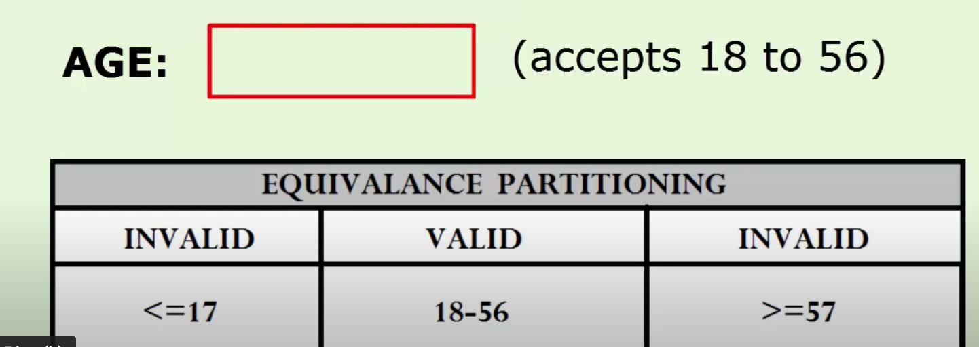
Equivalent Partitioning

Slide 5
Basis Path Testing
The following steps can be applied to derive the basis set:
Using the design or code as a foundation, draw a corresponding flow graph.
Determine the cyclomatic complexity of the resultant flow graph.
Determine a basis set of linearly independent paths.
Prepare test cases that will force execution of each path in the basis set.

Slide 6
Basis Path testing method
While loop
while (x<y)
{
Print{“the value”};
}
1
2
3

Slide 7
Basis Path Testing
1
2
3

Slide 8
Basis Path Testing
Cyclomatic Complexity
It is a source code complexity measurement that is being correlated to a number of coding errors.
It is calculated by developing a control Flow Graph of the code that measures the number of linearly-independent paths through a program module.
The cyclomatic complexity V(G) can be calculated as:
V(G) = regions
V(G)= predicate nodes (P) + 1
V(G)= No. of edge (E)- No. of nodes (N)+2

Slide 9
Basis Path Testing
For above case
V(G) = 2 regions
V(G) = Predicate Node +1 = 1+1 = 2
V(G) = 3edges- 3 nodes +2 = 2

Slide 10
Basis Path Testing
Linearly Independent Path
Path 1 = 1-2-1-3
Path 2 = 1-3

Slide 11
Basis Path Testing
Prepare test case
For Path 1 = 1-2-1
A test case is x= 5 and y = 7
For Path 2 = 1-3
A test case is x =7 and y =5

Slide 12
Basis Path Testing
If (x<y)
{
Print(“”success)
}
else
{
Print(“fail”)
}

